Slide 1
Sprocket Central Pvt Lmt (1)
File created on: 4/11/2023 2:36:06 PM

Slide 2
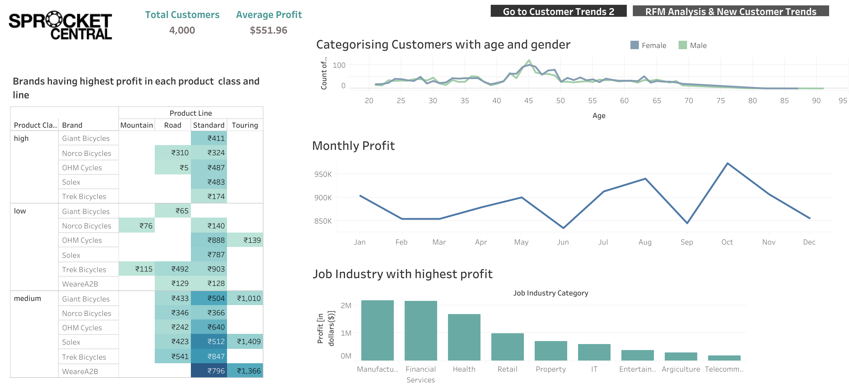

Slide 3
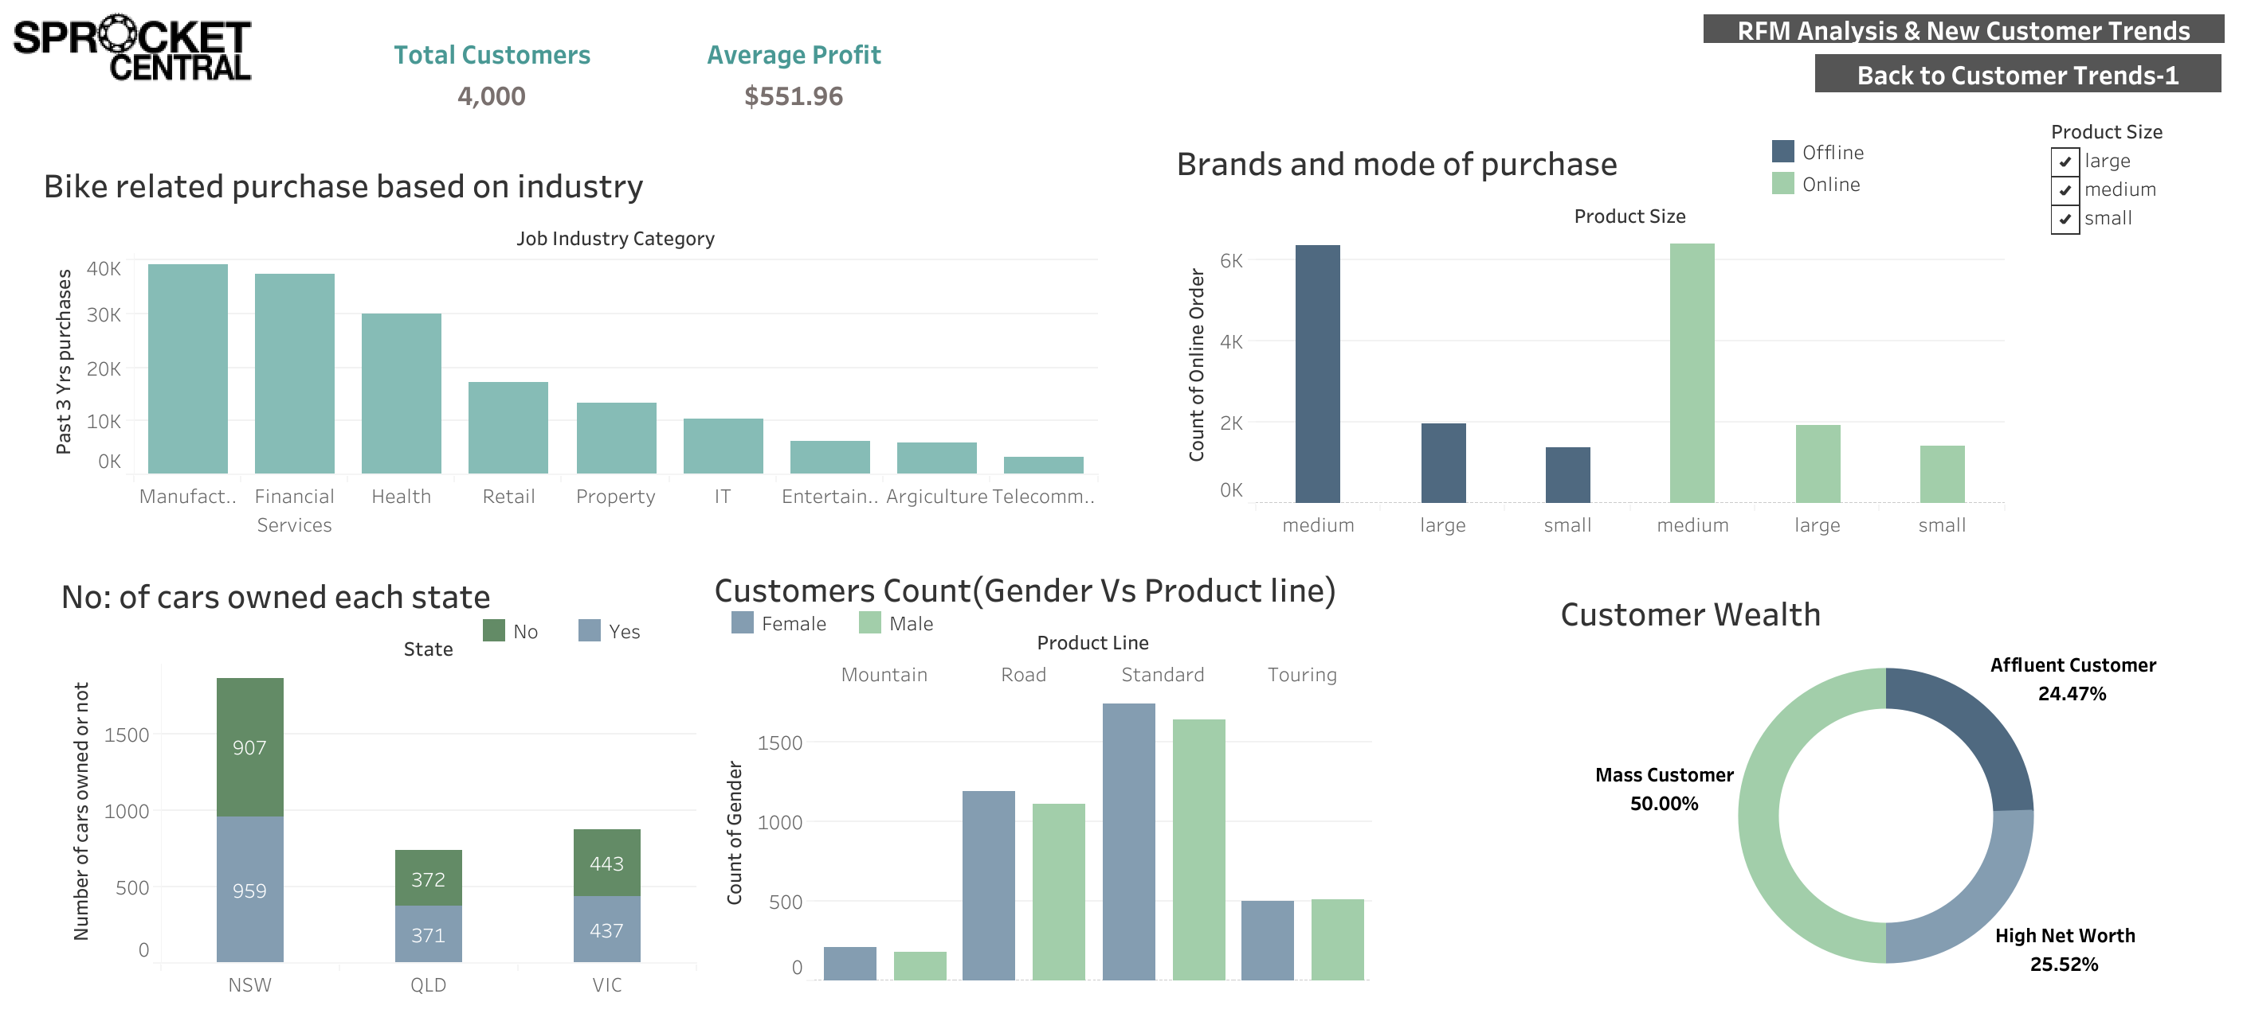

Slide 4
